Slide 1


Final Year Project Proposal
GroceryGo
A Smart Online Grocery Platform with Flexible Delivery, Product Substitution and Local Price Comparison
Supervised By: Mr. Ishtiaq Ali

Slide 2
Project Team
Uzair Mahmood (48405)
Arsalan Shah (47718)

Slide 3
Table of Contents
1. Opportunity & Stakeholders
2. Existing Systems
3. Problem Statement
4. Proposed Solution
5. Project Scope

Slide 4
Opportunity & Stakeholders
Opportunity:
People increasingly order groceries through mobile apps.
Customers need more control over when their groceries are delivered.
Product unavailability can make customers change or cancel their order.
Customers may want to compare prices from nearby stores before buying.
Frequently purchased items can take time to find again.
Customers need an easy way to report problems and give suggestions.
Goal:
To provide a grocery platform that makes ordering, delivery planning, money management and product selection easier for customers.

Slide 5
Stakeholders
Primary:
Customers, Grocery Stores, Delivery Riders
Secondary:
System Administrator, Customer Support Team

Slide 6
Existing Systems
Features | GroceryGo | Pandamart | Careem Quik | Grocer App | Bazar Tech | Amazon Fresh
Smart Delivery Slot selection | ✅ | ❌ | ❌ | ❌ | ❌ | ❌
Substitution Problem | ✅ | ✅ | ✅ | ❌ | ✅ | ✅
Price comparison across different local stores | ✅ | ❌ | ❌ | ❌ | ❌ | ❌
Past Purchases | ✅ | ✅ | ✅ | ✅ | ✅ | ✅
Repeat items | ✅ | ❌ | ❌ | ❌ | ❌ | ❌

Slide 7
Existing Systems
Features | GroceryGo | Pandamart | Careem | Grocer app | Bazar Tech | Amazon Fresh
Money management | ✅ | ❌ | ❌ | ❌ | ❌ | ❌

Slide 8
Problem Statement
Elements | Description
The problem of | No proper customized delivery option and no system to encourage customers to follow their selected delivery time
Affects | Customers who want their order at a specific future time and the delivery system
The result of which | Customers may select a delivery time but not be available to receive the order, which can cause delays and affect delivery efficiency
Benefits of solving it | Customers can select a future time such as 5:00–5:30 PM or 5:00–6:00 PM. Customers who do not receive their order at the selected time will receive a time/priority penalty, not a monetary penalty. Customers who regularly follow their selected delivery times will earn points. After reaching 100 points, the customer gets free delivery
Limitation | Customized delivery must have at least one hour gap from the current time.

Slide 9
Problem Statement
Elements | Description
The problem of | Products may become unavailable after the customer selects them
Affects | Customers who want a specific brand, size or quantity
The result of which | Customers may receive an unwanted replacement or may need to search for another product themselves
Benefits of solving it | The system can suggest suitable alternatives
Example | If Nestle Milk 250ml is unavailable: Nestlé Milk 500ml Nestlé Milk 1L Other available brands such as Olper's, Dayfresh, Nurpur or Haleeb No Replacement.

Slide 10
Problem Statement
Elements | Description
The problem of | Customers cannot easily compare grocery prices from nearby stores
Affects | Customers who want to control their grocery budget
The result of which | Customers may buy a product without knowing that the same product is available at a lower price nearby
Benefits of solving it | Customers can search for products and compare prices from multiple nearby stores before placing an order.

Slide 11
Problem Statement
Elements | Description
The problem of | Finding previously purchased grocery items again
Affects | Customers who regularly buy the same products
The result of which | Customers have to search for the same products again and again
Benefits of solving it | View Past Purchases Quickly find previously ordered products Easily order commonly purchased items again

Slide 12
Problem Statement
Elements | Description
The problem of | Customers may not know how to manage their grocery budget according to the number of people and their basic needs.
Affects | Customers who have a limited grocery budget or need to plan groceries for different numbers of people.
The result of which | Customers may spend too much on non-essential products and may not have enough budget for essential grocery items.
Benefits of solving it | A Money Management feature will help customers create a grocery plan according to their selected Person and Budget options.

Slide 13
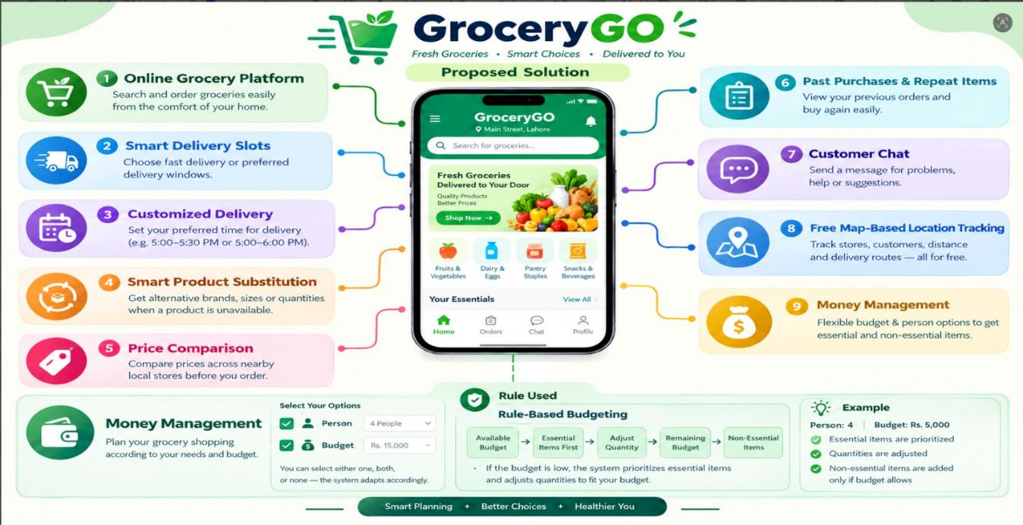
Proposed Solution

Slide 14
Project Scope
Category | Features
Customer Features | Registration and login, Grocery Search, Online Ordering
Delivery Reward Features | Time/Priority Penalty, Reward Points, 100 Points = Free Delivery
Delivery Features | Delivery slot selection, Customized delivery
Product Features | Product substitution, Alternative sizes, Alternative brands
Shopping Features | Local price comparison, Past Purchases, Repeat items
Support Features | Chat with Us, Problems & Suggestions
Location Features | Store location, Delivery location, Distance calculation
Store Features | Manage products, Price and availability
Admin Features | Manage users, Stores, Orders and system data
Budget Management | Rule Based Budgeting , Low-Budget Quantity Adjustment, Essential Items Prioritized First

Slide 15
THANK YOU

